Slide 1
CS 4530: Fundamentals of Software Engineering Lesson 5.4 Continuous Delivery
Rob Simmons
Khoury College of Computer Sciences

Slide 2
Continuous Delivery
“Faster is safer”: Key values of continuous delivery
Release frequently, in small batches
Maintain key performance indicators to evaluate the impact of updates
Phase roll-outs
Evaluate business impact of new features
Notes:
Thanks to the automated software integration pipeline that we’ve built, we can now work on closing the last feedback loop: by delivering our updates frequently, we can observe the impact of each update in relative isolation. We can be agile - releasing frequently, in small batches of updates. Thanks to automation from our CI + infrastructure system, we should be able to release with relatively low human overhead. We can maintain performance indicators like crashes, or latency and work on improving them. We can roll-out these changes to just a few users before shipping to everyone, and use this data to help determine if we should do that roll-out or not. We can even use this approach to evaluate whether newly designed features are used by users as our product designers intended - for instance, if we are implementing improvements to the usability of a commenting system, we might measure whether there are more comments made using the new feature or not. There are a few tricks that we can use to make this all work (and not make our software worse).

Slide 3
Continuous Delivery is about deciding which new features to deliver, and when
You have a large system with many engineers working on new features (and bug fixes ☺)
When a new feature or fix is ready, how do you roll it out to your users?

Slide 4
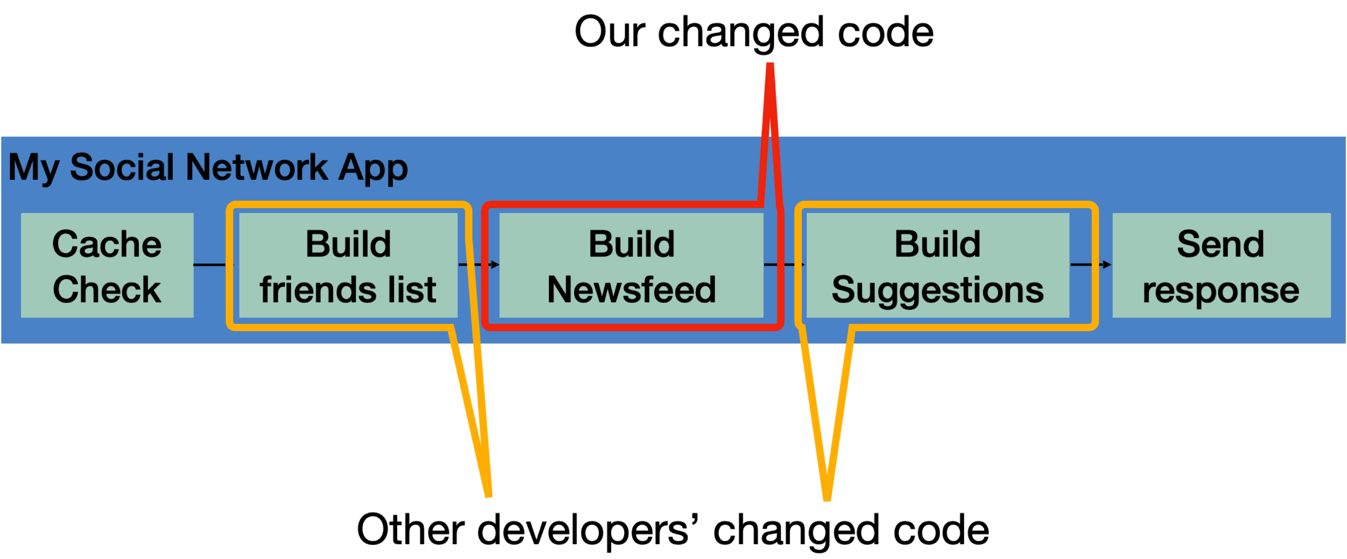
A continuous-delivery process is also a software pipeline
Automate this centrally, provide a central record of results
Develop
Build
Test
Deploy
Monitor
0…………….
Code Review
Style Check
Integration Test
End-to-end Test
KPIs
0…………….
Compile
Load Test
Unit Test
Prepare Deployment
Notes:
So, the core to continuous integration is to centrally and automatically execute these development processes, regularly.
With CI, we continuously assemble and test changes to our codebase. By performing these integrations quickly and frequently, we can get faster feedback, and hence, “shift left” - allowing bugs to be detected sooner. There’s an enormous difference in how long it takes to debug something if you detect the bug immediately after writing the code versus even, say, the next day - let alone after several weeks.
CI processes are software pipelines. “Pipeline” systems are good for building systems that have a specific order of operations, with dependencies between some steps. CI workflows follow this pattern: some steps depend on others (can’t test until you build), but many steps might be possible in parallel (run many different kinds of tests concurrently)
Consider our “social network application”, where we are changing code that builds a newsfeed, and other developers are changing other parts of the code? What concrete steps do you think that we should include in the build/test CI? Keep in mind that these might be things that you would otherwise do manually, but now have decided to automate.
<Examples, in case they don’t come up: Run unit tests, run integration tests, run international localization tests, validate that it still works with some infrastructure deployment, do regression testing, accessibility testing, check/gate on various quality metrics like coverage, security audit, code review>

Slide 5
Continuous Delivery does not mean Immediate Delivery
Even if you are deploying every day (“continuously”), you still have some latency
A new feature I develop today won't be released today
But, a new feature I develop today can begin the release pipeline today (minimizes risk)
Release Engineer: gatekeeper who decides when something is ready to go out, oversees the actual deployment process
Notes:
(read slide). Important bit is that there is latency to get to production – start dogfooding right away, but not release to public

Slide 6
Ways to mitigate deployment risks
Use a realistic staging environment
Use post-deployment monitoring
Use split deployments
Use tools to automate deployment tasks

Slide 7
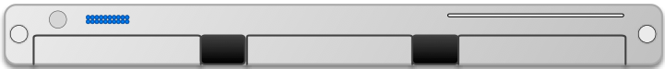
Build a staging environment to qualify features for delivery
Developer Environments
Beta/Dogfooding
User Requests
Testing Environment
Staging Environment
Production Environment
Revisions are “promoted” towards production
Q/A takes place in each stage (including production!)
Notes:
Once a project is configured with IaC, it is relatively easy to have *multiple* operating clusters running an application.
This is a crucial step for enabling continuous delivery, where it is necessary to have some non-production deployments for, e.g. internal users/dogfooding.
These different deployment environments create a “deployment pipeline”, where code changes get “promoted” from one level of deployment to the next.
At each deployment step, there are extensive Q/A processes that help ensure confidence that the software is ready to ship.
Most continuous delivery pipelines involve at least these three phases, but in practice, there may be many staging environments, and several versions of the software deployed in production concurrently.

Slide 8
Split Deployments Mitigate Risk
Lower risk if a problem occurs in staging than in production
Or deploy to a small set of users before deploying more widely
Names:
“Eat your own dogfood”
Beta/Alpha testers
A/B testing
"canaries"
Notes:
Continuous delivery allows the promise of having the benefits of testing with real users, while mitigating the risk of a costly failure.
Continuous delivery models rely on what are called “split deployments” – when a feature is initially deployed, it is not put in front of all users. Instead, there are multiple (“split”) deployments of the entire product. New features and changes are deployed to environment that has a smaller set of users who will be less impacted by bugs.
This way, there is an opportunity to identify any tricky integration-related flaws “that would only show up in production”, without having to risk upsetting people.
One example model of a split deployment is the “eat your own dogfood” model – you force your own employees to use this “pre-release” version of the app, knowing that they will be more tolerant of a crash than an end-user. For example, all Facebook employees get a company phone with a pre-release Facebook app installed.
Another example model is the alpha/beta model, where a focus group of users opt-in to use these pre-production environments.

Slide 9
Post-delivery monitoring mitigates risk
Consider both direct (e.g. business) metrics, and indirect (e.g. system) metrics
Hardware
Voltages, temperatures, fan speeds, component health
OS
Memory usage, swap usage, disk space, CPU load
Middleware
Memory, thread/db connection pools, connections, response time
Applications
Business transactions, conversion rate, status of 3rd party components
Notes:
A key enabling technology for continues delivery is metric monitoring. There might be a wide range of metrics that we can monitor to gain insights into the performance characteristics of our application (read slide)
<Ask student to brainstorm what “business metrics” might be for facebook>

Slide 10

Continuous Delivery Tools
Simplest tools deploy from a branch to a service (e.g. Render.com, Heroku)
More complex tools:
Auto-deploys from version control to a staging environment + promotes through release pipeline
Monitors key performance indicators to automatically take corrective actions
Example: “Spinnaker” (Open-Sourced by Netflix, c 2015)
Example CD pipeline from Spinnaker’s documentation: https://spinnaker.io/docs/concepts/#application-deployment
Notes:
Manually constructing and deploying to these multiple environments (and pushing changes through them) is time consuming and error prone.
A variety of tools exist to manage this process.
For this class, we’ll use fairly simple continuous delivery tools that will auto-deploy our code from a branch after its CI checks pass.
However, there are, of course, tools that fully automate more complex workflow, including canary deployments, rollbacks, etc.
<read slide. The figure is an example CD pipeline from spinnaker’s documentation>

Slide 11
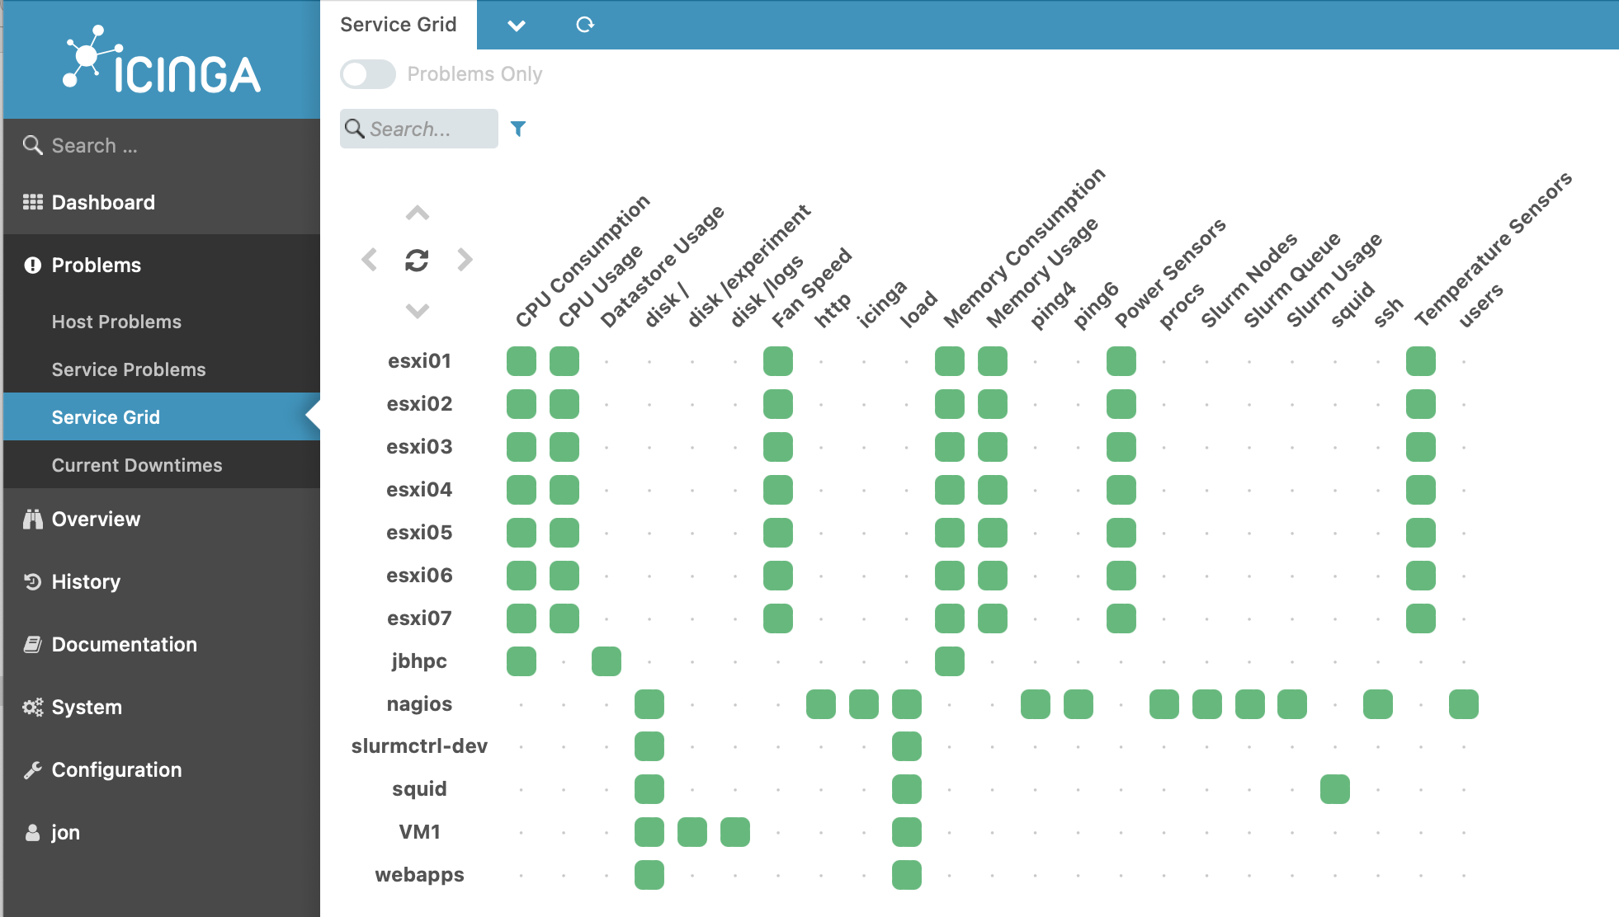
Tools for Monitoring Deployments
Nagios (c 2002): Agent-based architecture (install agent on each monitored host), extensible plugins for executing “checks” on hosts
Track system-level metrics, app-level metrics, user-level KPIs
Notes:
* Nagios is a recursive acronym: "Nagios Ain't Gonna Insist On Sainthood"[4] – "sainthood" makes reference to the original name NetSaint, which changed in response to a legal challenge by owners of a similar trademark.[ https://archive.fosdem.org/2005/index/interviews/interviews_galstad.html
Here is a screenshot of the Iciniga (good luck pronouncing it, try Aye-Singa)

Slide 12
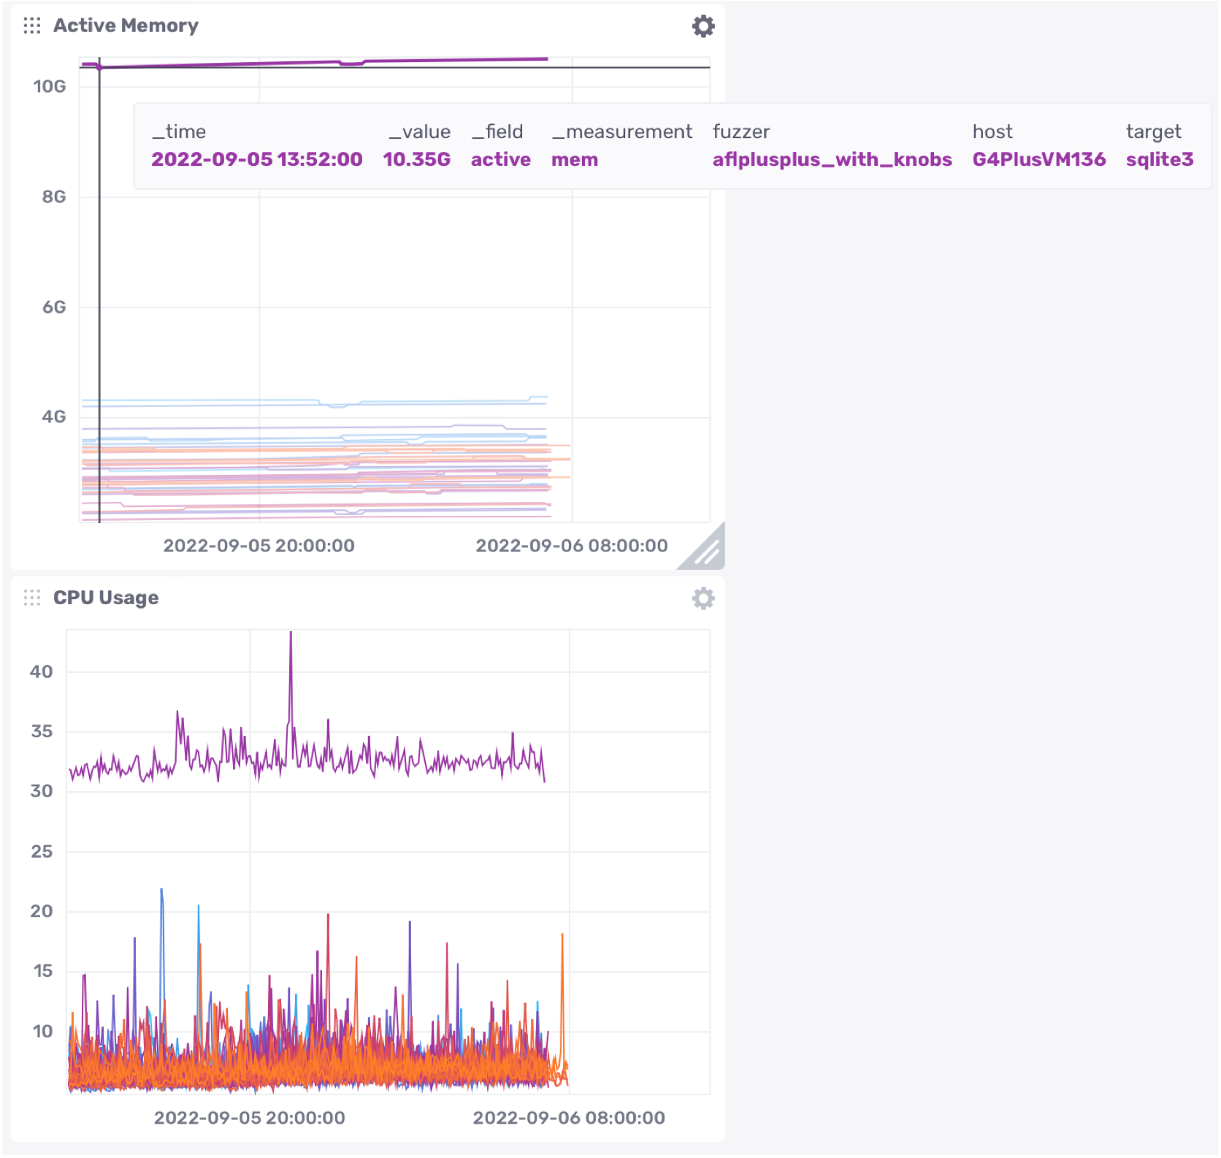
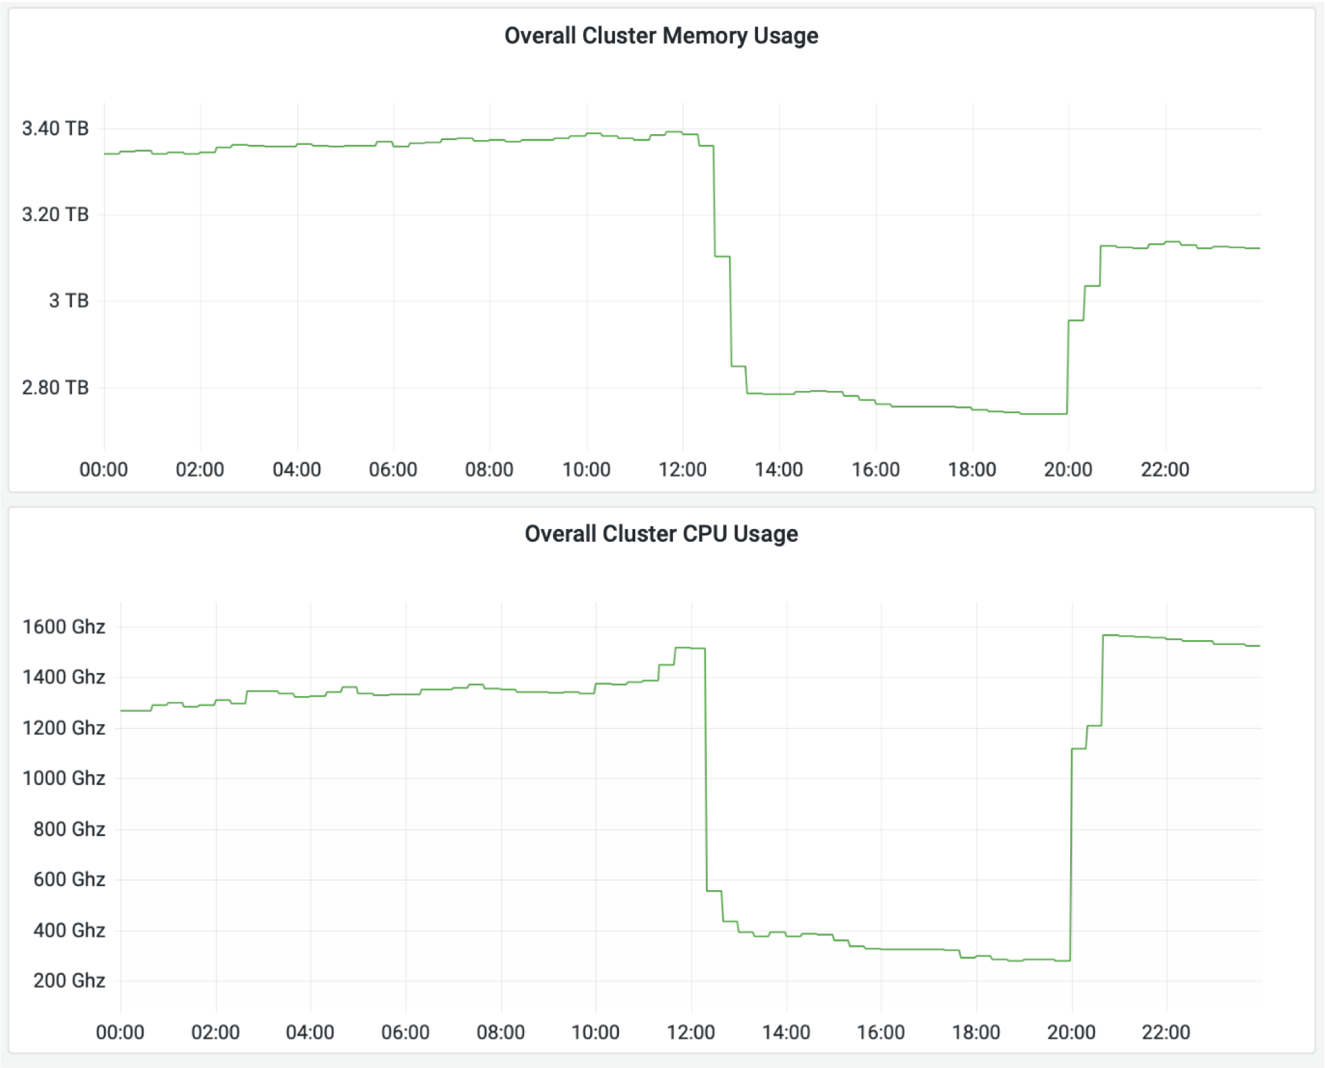
Monitoring can help identify operational issues
Grafana (AGPL, c 2014)
InfluxDB (MIT license, c 2013)
Notes:
Dashboards that aggregate multiple KPIs into one place allow a human operator to gather insights by putting in one place all of the kinds of metrics that we just saw.
Once data like this is being tracked, it’s easier to gain high-level insights by plotting it and using an interactive interface to query it. This screenshot is taken from an open-source analytics and interactive visualization product called InfluxDB.
On the left, we can see some overall hardware metrics (memory and CPU usage). On the right, we can see a drill down that shows the actual memory and CPU usage for each of many different applications that are running concurrently. We can see that there is a single outlier application in both memory and CPU usage; in the top right screenshot we can see that this application is using 10.35GB RAM, running on host “G4PlusVM136” and running target “sqlite3”. This kind of information is useful for detecting potential performance regressions before they cause more significant problems.

Slide 13
How should we allocate our testing resources?
How much unit testing should be required?
When should we do code reviews?
How often should we do integration tests?
Different organizations may make different choices

Slide 14
Two extremes(?) Continuous Delivery vs. TDD
Test driven development
Write and maintain tests per-feature (manual! hard!)
Unit tests help locate bugs (at unit level)
Integration/system tests also needed to locate interaction-related faults
Continuous delivery
Write and maintain high-level observability metrics
Deploy features one-at-a-time, look for canaries in metrics
Write fewer integration/system tests
Notes:
<read slide>
In many startups (including Facebook), writing large test suites is not ideal. Think about the original critiques of waterfall vs agile: waterfall had “lots of wasted products” – e.g. when the wrong feature is developed. Agile can still have wasted products, too – what if you build and test a feature that you don’t end up needing? Continuous delivery allows you to reduce the number of tests that you write, because you rely on internal deployments and alpha and beta testers for feedback. This allows for faster time to market.
However, as we have seen in the case studies in this lecture, to really get the *safety* of continuous delivery, you need a real process that:
Deploys features one-at-a-time. If multiple features are deployed together, you won’t be able to tell which feature causes a defect that you observe in production
Monitors key indicators, allowing you to determine quickly if a change introduces a bug
Automatically reverts changes that introduce bugs, reducing impact
<Ask students: Do you think facebook uses TDD? Why/why not? The answer is that they don’t. Kent Beck joined facebook and tried to make people use TDD and he was literally told he was going to be fired within his first few weeks if he didn’t spend more time writing features and less time writing tests>

Slide 15
CI at scale: Google Test Automation Platform (TAP (2020))
Massive continuous build of entire Google codebase
in a dedicated data center
50,000 unique changes per-day, 4 billion test cases per-day
Engineers submit unit tests along with their changes
Block merge if they fail
If they pass, change is put in the codebase.
visible to entire company!
average wait time to this point: 11 minutes
Then (asynchronously) run all affected integration tests
If any fail, change is sent back to a human on the submitter's team (the “build cop”) who must act immediately to roll-back or fix.
“Software Engineering at Google: Lessons Learned from Programming Over Time,” Wright, Winters and Manshreck, 2020 (O’Reilly), pp. 494-497
Notes:
Google Test Automation Platform

Slide 16
Facebook: "Move fast and break things"
de-prioritize unit tests
Emphasis on getting features to users quickly
Strategy: push many small changes to fractions of the user base. ("split deployments")

Slide 17
Deployment Example: Facebook.com
Pre-2016
Developers working in their own branch
When feature is ready, push as 1 change to master branch
~1 week of development
~1 week of development
master branch
3 days
4 days
All changes that survived stabilizing
Stabilize
Release Branch
Weekly
All changes from week
that are ready for release
release branch
production
Your change doesn’t go out unless you’re there that day at that time to support it!
3x Daily
“When in doubt back out”
Notes:
https://engineering.fb.com/2017/08/31/web/rapid-release-at-massive-scale/
Here is an example of a large-scale continuous deployment pipeline.
This chart shows the overall process that was used before 2016 to deploy Facebook.com. (read diagram; important bits: dev branches get merged into master, then once a week all changes from the past week are pulled into a release branch. For 3 days they “stabilize” the release branch – find changes that are causing very bad behavior and back them out. Then for the last 4 days of the week, every change that survived that stabilization gets individually pushed to production batched so that this happens 3x/day. Important to do small deploys so that you can isolate bad changes)
What was bad about this? Didn’t scale. How many changes going out? 500-700 PER DAY. By 2016 might be pushing 10k diffs per week. ENORMOUS effort to co-ordinate (between the “your change doesn’t go out unless you’re there to support it” and “when in doubt back it out” – both very manual)
(From the blog post):
For many years, we pushed the Facebook front end three times a day using a simple master and release branch strategy. Engineers would request cherry-picks — changes to the code that had passed a series of automated tests — to pull from the master branch into one of the daily pushes from the release branch. In general, we saw between 500 and 700 cherry-picks per day. Once a week, we’d cut a new release branch that picked up any changes that were not cherry-picked during the week.
By 2016, we saw that the branch/cherry-pick model was reaching its limit. We were ingesting more than 1,000 diffs a day to the master branch, and the weekly push was sometimes as many as 10,000 diffs. The amount of manual effort needed to coordinate and deliver such a large release every week was not sustainable.

Slide 18
Facebook used to have an elaborate system of branches
dev branches got merged into master,
then once a week all changes from the past week were pulled into a release branch (often 10,000 changes per week)
For 3 days they “stabilized” the release branch – find changes that are causing very bad behavior and back them out. (manual process!!)
Then for the last 4 days of the week, every change that survived that stabilization got individually pushed to production batched so that this happens 3x/day.
Important to do small deploys so that you could isolate bad changes.
Notes:
https://engineering.fb.com/2017/08/31/web/rapid-release-at-massive-scale/
Here is an example of a large-scale continuous deployment pipeline.
This chart shows the overall process that was used before 2016 to deploy Facebook.com. (read diagram; important bits: dev branches get merged into master, then once a week all changes from the past week are pulled into a release branch. For 3 days they “stabilize” the release branch – find changes that are causing very bad behavior and back them out. Then for the last 4 days of the week, every change that survived that stabilization gets individually pushed to production batched so that this happens 3x/day. Important to do small deploys so that you can isolate bad changes)
What was bad about this? Didn’t scale. How many changes going out? 500-700 PER DAY. By 2016 might be pushing 10k diffs per week. ENORMOUS effort to co-ordinate (between the “your change doesn’t go out unless you’re there to support it” and “when in doubt back it out” – both very manual)
(From the blog post):
For many years, we pushed the Facebook front end three times a day using a simple master and release branch strategy. Engineers would request cherry-picks — changes to the code that had passed a series of automated tests — to pull from the master branch into one of the daily pushes from the release branch. In general, we saw between 500 and 700 cherry-picks per day. Once a week, we’d cut a new release branch that picked up any changes that were not cherry-picked during the week.
By 2016, we saw that the branch/cherry-pick model was reaching its limit. We were ingesting more than 1,000 diffs a day to the master branch, and the weekly push was sometimes as many as 10,000 diffs. The amount of manual effort needed to coordinate and deliver such a large release every week was not sustainable.

Slide 19
Deployment Example
“Our main goal was to make sure that the new system made people’s experience better — or at least, didn’t make it worse. After a year of planning and development, over the course of three days we enabled 100% of our production web servers to run code deployed directly from master”
Chuck Rossi, Director Software Infrastructure & Release Engineering @ Facebook
“Rapid release at massive scale” https://engineering.fb.com/2017/08/31/web/rapid-release-at-massive-scale/
Notes:
So, Facebook re-architected their release process. (pause to read quote)
The “people” whose experiences were improved were:
- Devs trying to get changes deployed (who wanted the most frictionless process)
- Build cops and release engineers who were responsible for executing the QA and overall process.

Slide 20
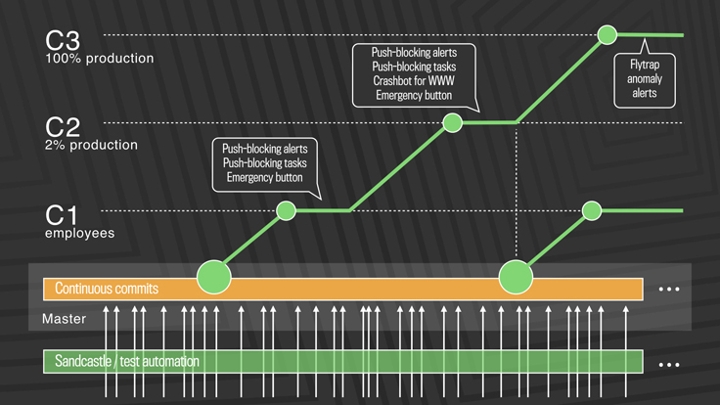
Post-2016: truly continuous releases from master branch
https://engineering.fb.com/2017/08/31/web/rapid-release-at-massive-scale/
Notes:
This approach solves the problem of scaling continuous delivery. In Facebook’s new deployment model, there is no manual cherry-picking, and there are automated processes to detect anomalies and revert changes. There are three-tiers of deployment, from C1 (dog-fooding/staging) to C2 (deployment to a small slice of production) to C3 (deployment to entirety of production workload)
The process works like this: (copied from blog post)
First, diffs that have passed a series of automated internal tests and land in master are pushed out to Facebook employees. In this stage, we get push-blocking alerts if we’ve introduced a regression, and an emergency stop button lets us keep the release from going any further. If everything is OK, we push the changes to 2 percent of production, where again we collect signal and monitor alerts, especially for edge cases that our testing or employee dogfooding may not have picked up. Finally, we roll out to 100 percent of production, where our Flytrap tool aggregates user reports and alerts us to any anomalies.
Many of the changes are initially kept behind our feature flags, which allows to roll out mobile and web code releases independently from new features, helping to lower the risk of any particular update causing a problem. If we do find a problem, we can simply switch the feature off rather than revert back to a previous version or fix forward.

Slide 21
Post-2016: Truly Continuous Releases from Master Branch (excerpts from blog post)
First, diffs that have passed a series of automated internal tests and land in master are pushed out to Facebook employees.
In this stage, get push-blocking alerts if we’ve introduced a regression, and an emergency stop button lets us keep the release from going any further.
If everything is OK, push the changes to 2 percent of production, where again we collect signal and monitor alerts, especially for edge cases that our testing or employee dogfooding may not have picked up.
Finally, roll out to 100 percent of production, where our Flytrap tool aggregates user reports and alerts us to any anomalies.
Many of the changes are initially kept behind feature flags, which allows to roll out mobile and web code releases independently from new features, helping to lower the risk of any particular update causing a problem.
If we do find a problem, simply switch the feature off rather than revert back to a previous version or fix forward.
https://engineering.fb.com/2017/08/31/web/rapid-release-at-massive-scale/
Notes:
This approach solves the problem of scaling continuous delivery. In Facebook’s new deployment model, there is no manual cherry-picking, and there are automated processes to detect anomalies and revert changes. There are three-tiers of deployment, from C1 (dog-fooding/staging) to C2 (deployment to a small slice of production) to C3 (deployment to entirety of production workload)
The process works like this: (copied from blog post)
First, diffs that have passed a series of automated internal tests and land in master are pushed out to Facebook employees. In this stage, we get push-blocking alerts if we’ve introduced a regression, and an emergency stop button lets us keep the release from going any further. If everything is OK, we push the changes to 2 percent of production, where again we collect signal and monitor alerts, especially for edge cases that our testing or employee dogfooding may not have picked up. Finally, we roll out to 100 percent of production, where our Flytrap tool aggregates user reports and alerts us to any anomalies.
Many of the changes are initially kept behind our feature flags, which allows to roll out mobile and web code releases independently from new features, helping to lower the risk of any particular update causing a problem. If we do find a problem, we can simply switch the feature off rather than revert back to a previous version or fix forward.

Slide 22
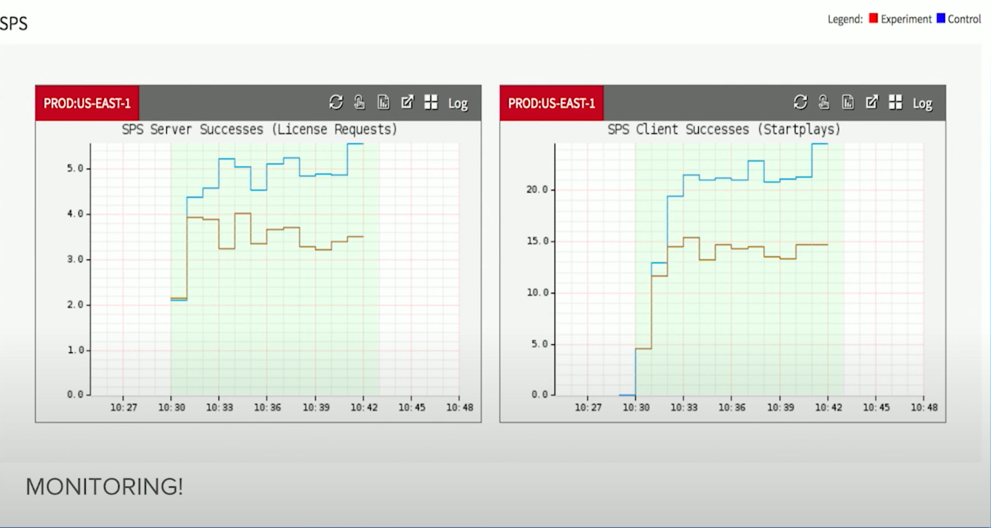
Continuous Delivery Tools Can Take Automated Actions
Example: Automated roll-back of updates at Netflix based on "streams-per-second" (SPS)
https://www.youtube.com/watch?v=qyzymLlj9ag
Notes:
In a real production scenario, we probably want to automate even more of a response than simply sending a notification.
Here is an example of application-level monitoring in practice, from Netflix. These monitoring graphs plot SPS, which is Netflix’s key business metric: “Stream starts per second” - can a user actually watch what they want to watch.
Graph shows a comparison between a “control” group (running old version of software, blue) and an “experiment” group (running new version proposed, shown in red). If SPS deviates between control and expected, auto-rollback occurs within seconds; no manual intervention is necessary.

Slide 23
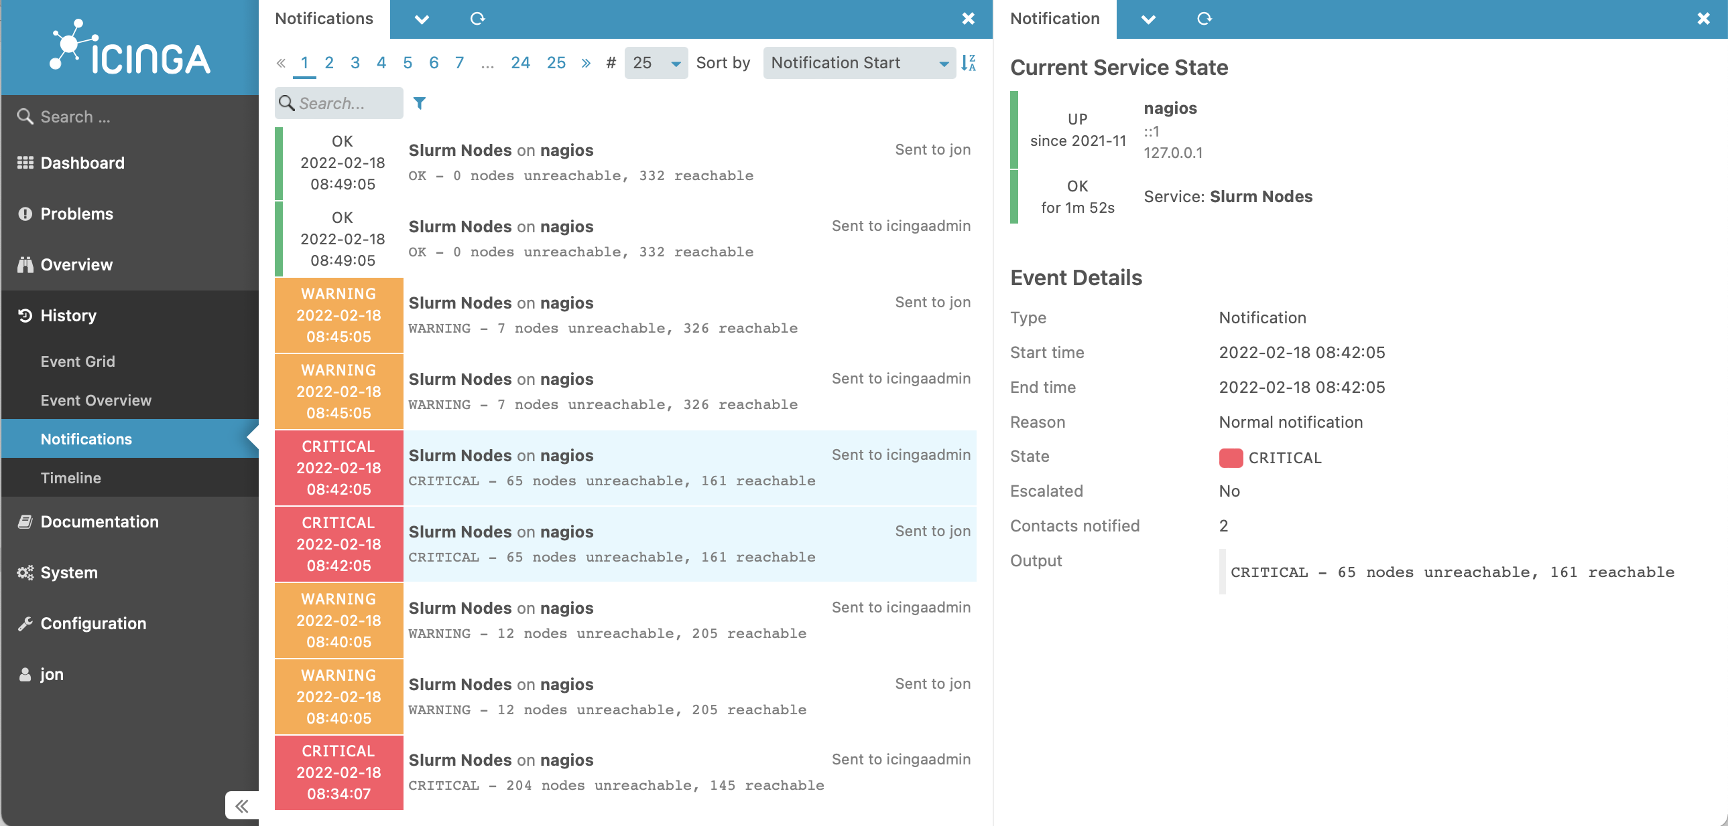
Monitoring Services Can Take Automated Actions
Notes:
Once we are monitoring these KPIs, it’s also possible to set up automated processes that take actions when certain events happen. Here’s a screenshot of another view of Icinga. One of the key kinds of actions that Icinga is designed to take is to simply track problems and run a series of escalating notifications to ensure that they get noticed and resolved. In this screenshot, you can see the various times that the “slurm nodes” application service degraded and then eventually entirely failed on Feb 18. Each entry shows a notification that was sent.
People pay money for PagerDuty.

Slide 24

From Monitoring to Observability
Understanding what is going on inside of our deployed systems by visualizing internal metrics
Example dashboard by DataDog:
https://www.datadoghq.com/blog/gke-dashboards-integration-improvements/
Notes:
One of the newest buzzwords around continuous delivery and monitoring is “observability” – the idea that an engineer who is responsible for operating the application can visualize what is happening inside of it, and use that input to improve the application. This screenshot shows an example of a dashboard provided by a popular SaaS observability tool called “Datadog”.
<note: many students likely have had experience using datadog on co-ops, it’s a good topic to ask about>

Slide 25

Beware of Metrics
McNamara Fallacy
Measure whatever can be easily measured
Disregard that which cannot be measured easily
Presume that which cannot be measured easily is not important
Presume that which cannot be measured easily does not exist
Notes:
When talking about quantitative metrics, it’s extremely important to consider how rigidly we follow them. Setting KPIs for monitoring is a very good idea, but not all important metrics can be easily measured quantitatively.
Robert McNamara was secdef in the 60’s, had previously been an executive at Ford where he made quantitative metrics for each phase of production and ruthlessly optimized to improve efficiency and production. Applied similar strategy to secdef… “Things you can count, you ought to count - loss of life is one” - so, based lots of strategy on body counts. Body count is one thing, but not the whole picture. After war ended in interviews, generals commented that body counts were misguided way to measure progress. Compare to: using LoC to track progress on a project… how do you even know how many lines there should be, and is it good to have a lot? Software metrics are very tricky because it it is hard to quantify everything.

Slide 26
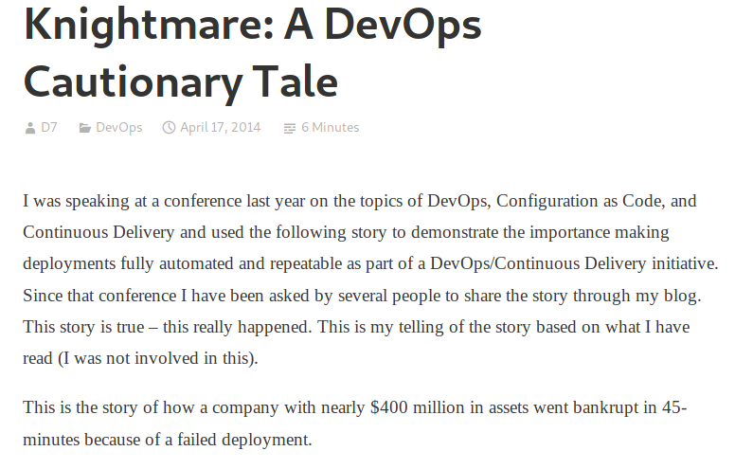
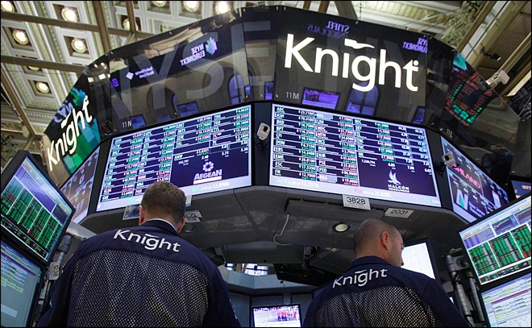
What not to do: Failed Deployment at Knight Capital
“In the week before go-live, a Knight engineer manually deployed the new RLP code in SMARS to its 8 servers. However, he made a mistake and did not copy the new code to one of the servers. Knight did not have a second engineer review the deployment, and neither was there an automated system to alert anyone to the discrepancy. “
https://www.henricodolfing.com/2019/06/project-failure-case-study-knight-capital.html
Notes:
The short of it:
Built a new trading system, created a system for testing that would attempt to drive prices up or down (at a significant loss per-transaction) in order to test system responses to market conditions
Had to manually deploy the new code to some servers…
Did not remove the testing code (“power peg”) from one of the eight
In first hour of trading the system bought $7 billion of stocks (money that Knight didn’t have)
No planned processes to monitor the deployed system or to roll back to a working one (they actually made it worse while trying to fix it, restoring the “power peg” testing code on all remaining servers - why not just shut the whole thing down?)
Goldman Sachs quite generously bailed out Knight capital, buying the $7b position for a $440m discount
Ask students to compare/contrast with the tail-strike situation, where after the second tail strike, all planes were grounded for 22 minutes while the problem was root-caused and a fix was instituted.

Slide 27
What could Knight capital have done better?
Use capture/replay testing instead of driving market conditions in a test
Avoid including “test” code in production deployments
Automate deployments
Define and monitor risk-based KPIs
Create checklists for responding to incidents
Notes:
The Knight capital story is definitely an interesting one, and perhaps now that we have discussed some strategies for continuous deployment, it is hopefully somewhat clearer how this enormous financial loss could have been prevented.
First, some comments on the testing strategy:
Why, why why why is it a good idea to write a test case that actually tries to change market conditions, when you could instead test your code using simulated/historical market conditions?
Never include testing code in production deployments: that test code for changing markets in order to test the system response to them was included in the production code!?!
Then on the deployments:
If deployment were automated, there would not be a step for an engineer to miss on one of the 8 deployments: they could always happen predictably
There was insufficient monitoring. The way that this error was detected was the NYSE had noticed that market volume was more than expected, and then traced it back to Knight. Nobody at Knight had thought to create a dashboard that monitored their volume (and perhaps more importantly, financial exposure vs assets at hand). This could have been detected *immediately* and automatically paged the relevant people (and perhaps also automatically paused the firm’s trading activities). Seems like a reasonable investment.
There were no checklists for responding to incidents, and no procedures to roll-back if needed. We’ll see that “If in doubt back it out” is the Facebook philosophy to avoid this kind of failure, but this requires a process to be in place so that it can be easily triggered

Slide 28
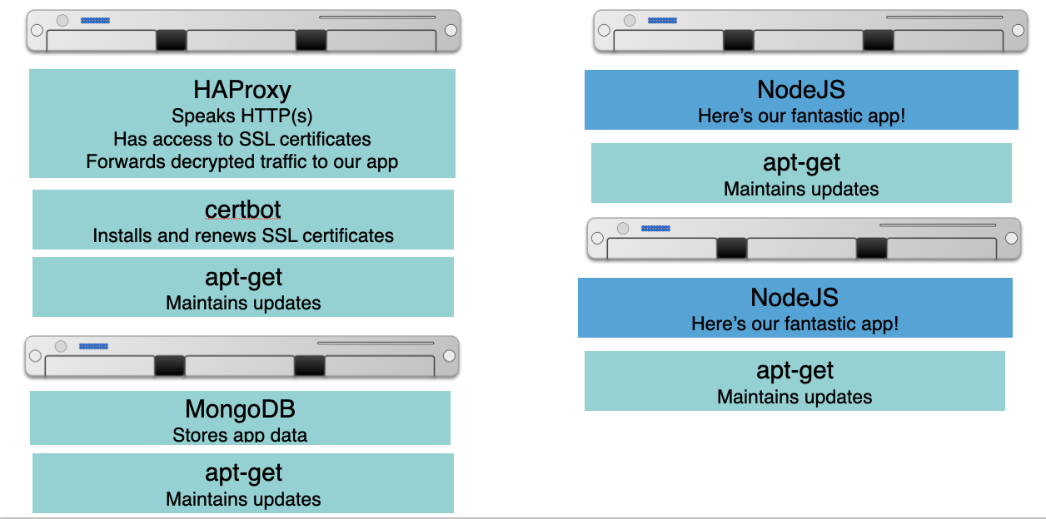
Aside: Infrastructure As Code
Provisioning servers is tedious and error prone
Deploy a VM, then ssh to it, install some packages, etc
Keeping servers up-to-date is also a struggle
Ideal:
“Give me HAProxy with some configuration file, and keep that configuration in a git repo, and when I change it, roll out an update”
“Give me some containers running my NodeJS app, and when I update my app, roll it out to those containers”
“Give me a bunch of servers with MongoDB set up in a cluster”
Notes:
Regardless of what tools you use to manage a CD pipeline, it is likely that you will rely on infrastructure as code.
The diagram on the right shows the infrastructure that you might need to run a medium-sized microservices app.
There is one VM that runs an HTTP proxy, receiving traffic from the outside world, and routing that traffic to one of two app servers running our fantastic app.
There is also a VM that runs a database.
There are also some ancillary services, like each VM has a tool for maintaining updates to the packages. The VM that receives incoming HTTPs requests also might need to have some other services for retrieving and updating an SSL certificate.
Imagine needing to manually set up and maintain this infrastructure. What happens when your boss asks for a new staging environment? What happens when there is a critical security vulnerability in an underlying package and you need to make sure that each part of your infrastructure is up-to-date?
This is the ideal set of goals that infrastructure as code aims to offer, which is crucial for enabling continuous delivery. Instead of manually deploying this infrastructure, developers can programmatically define what the infrastructure should look like, and leave it up to the Infrastructure as Code service to make it happen.

Slide 29
Infrastructure as Code represents complex infrastructure in “recipes”
Goal: Create a system that, when run, can automatically bring physical or virtual machines to some configured state
These configurations can then go into version control, code review, etc
Metaphor: “Recipes” for configuring servers, organized into “cookbooks”
Engineers define “healthy” states for infrastructure, then system automatically provisions, validates, and (if needed) repairs deployed resources
“Oh, this is how they do things at Amazon” - Inspiration for Chef, c 2009
Other tools with similar aims: Puppet (c 2005), Ansible (c 2012)
Notes:
<read slide, some notes:
There are a LOT of benefits of having your infrastructure (e.g. the set of boxes on the right) in version control – can ask students to brainstorm what they are (it’s shared with everyone who might need it, changes can be reviewed through exiting code review processes, YOU CAN EASILY REVERT CHANGES BY ROLLING BACK TO OLDER COMMIT, etc)
This procedure was happening inside of large cloud companies with proprietary, home-grown systems for some time. In 2009 a consultant partnered with a former operations lead at amazon, to create an open-source product that brought these concepts to the rest of the world
Other tools have come up since then that use different languages/interfaces to specify the infrastructure, and have somewhat different feature sets. We won’t go into them in detail, but you may have heard of, for example, Puppet or Ansible
>

Slide 30
Learning objectives for this lecture
It’s the end of today’s lecture, so you should be able to…
Describe how continuous integration helps to catch errors sooner in the software lifecycle
Describe strategies for performing quality-assurance on software as and after it is delivered
Compare and contrast continuous delivery with test driven development as a quality assurance strategy

